Slide 1

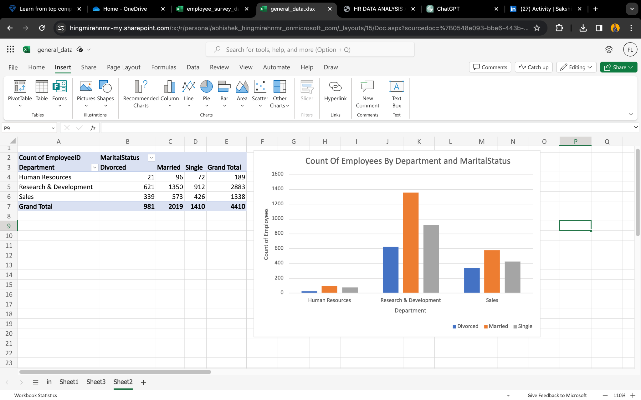


HR DATA
ANALYSIS
Abhishek Hingmire

Slide 2
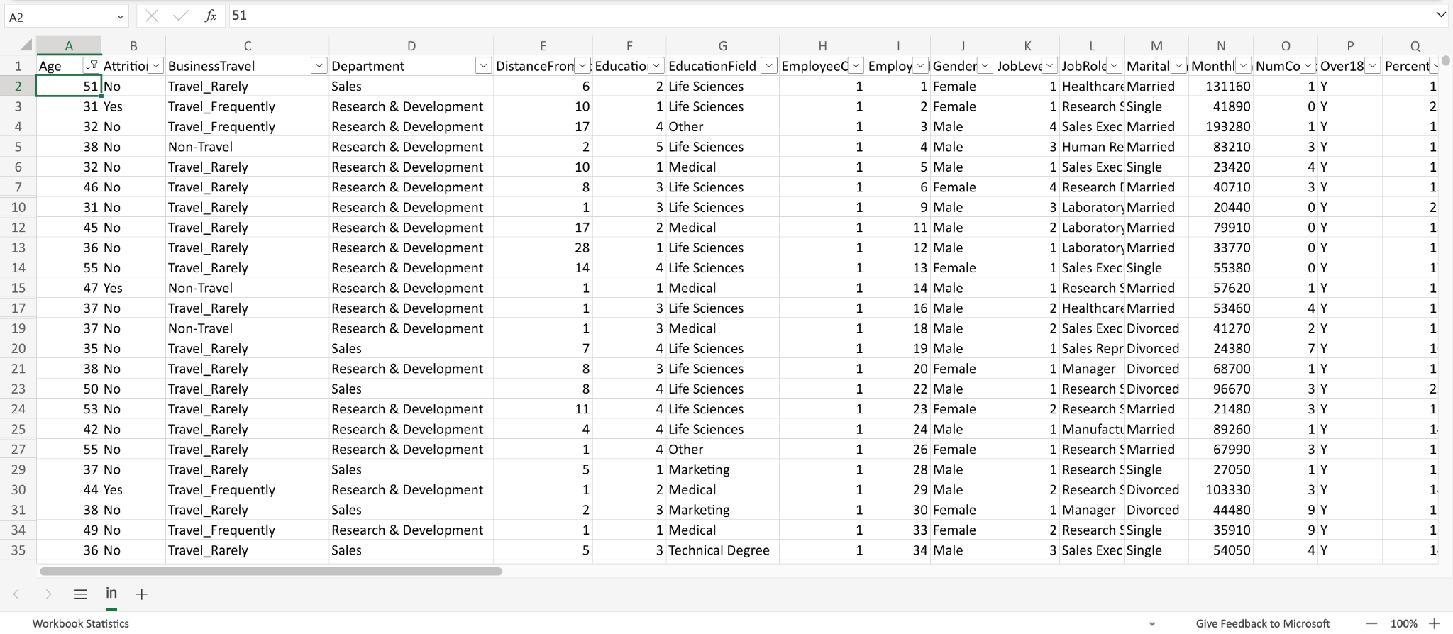
1. Using Excel, how would you filter the dataset to only show employees aged 30 and above?

Slide 3
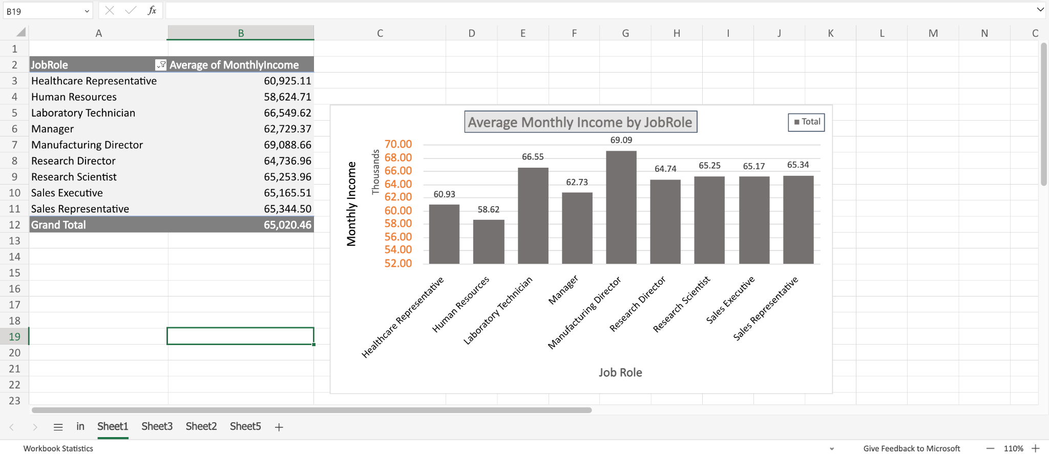
2. Create a pivot table to summarize the average Monthly Income by Job Role

Slide 4
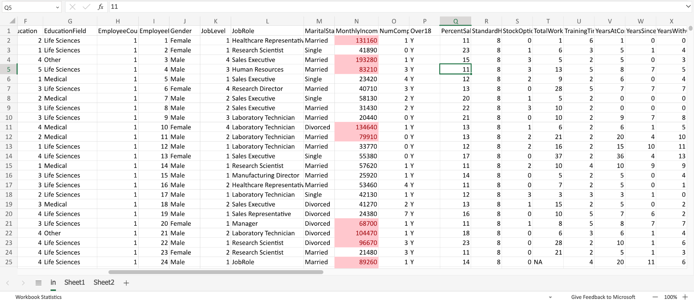
3. Apply conditional formatting to highlight employees with Monthly Income above the company's average income.
1

Slide 5
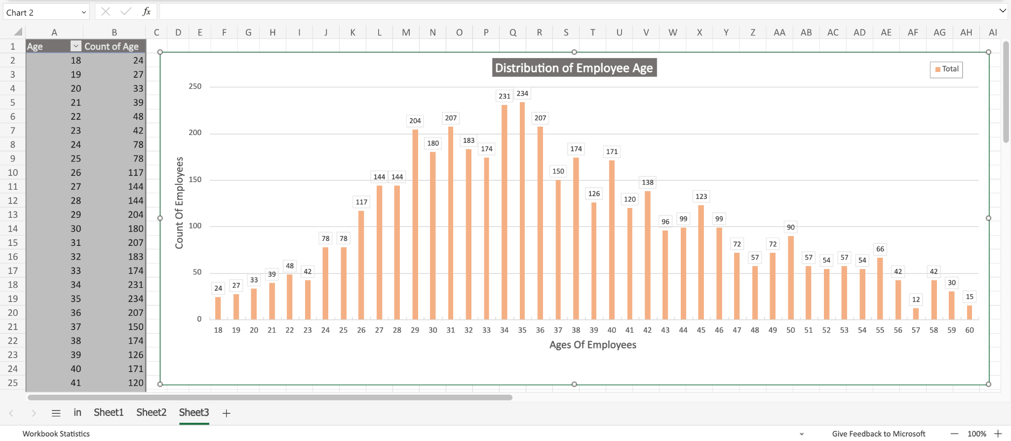
4. Create a bar chart in Excel to visualize the distribution of employee ages.

Slide 6
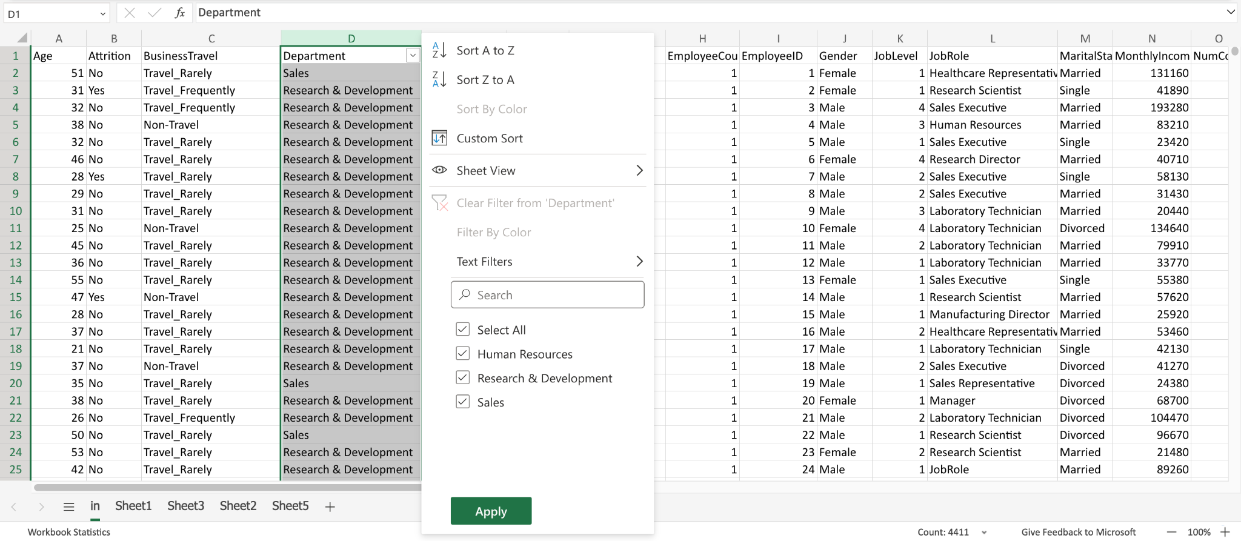
5. Identify and clean any missing or inconsistent data in the "Department" column.
Result: There is no inconsistent data

Slide 7
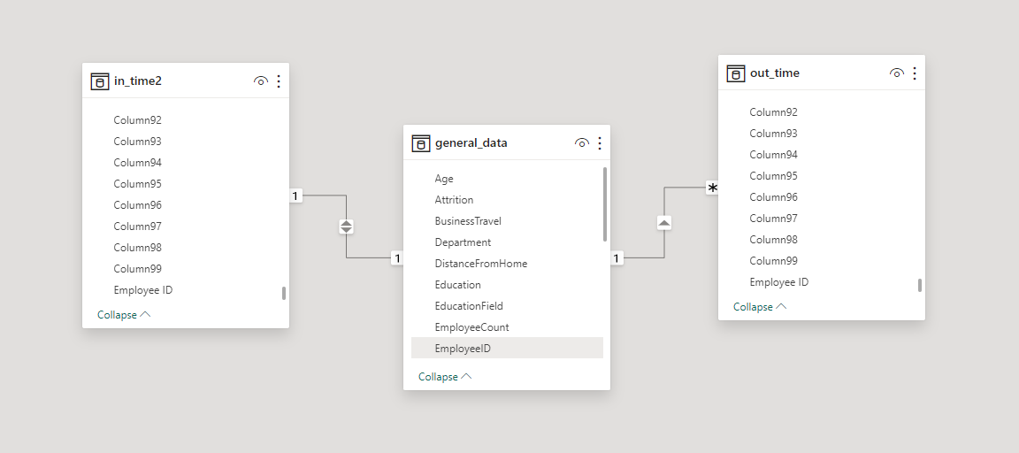
6. In Power BI, establish a relationship between the "EmployeeID" in the employee data and the "EmployeeID" in the time tracking data.

Slide 8
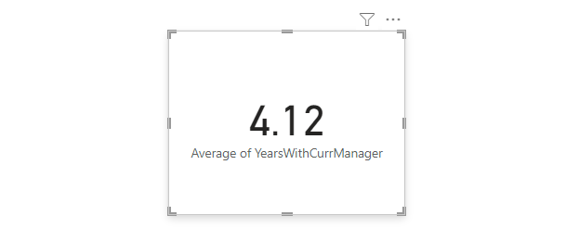
7. Using DAX, create a calculated column that calculates the average years an employee has spent with their current manager.

Slide 9
8. Using Excel, create a pivot table that displays the count of employees in each Marital Status category, segmented by Department.

Slide 10
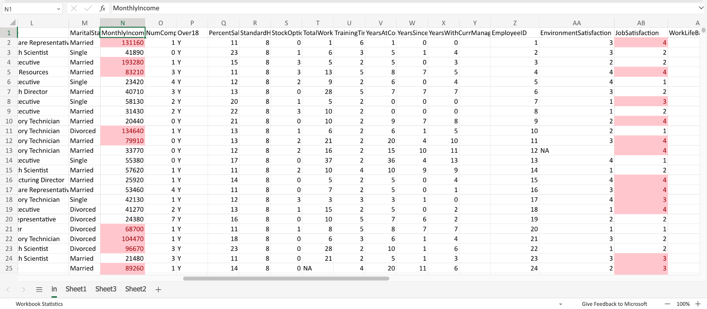
9. Apply conditional formatting to highlight employees with both above-average Monthly Income and above-average Job Satisfaction.

Slide 11
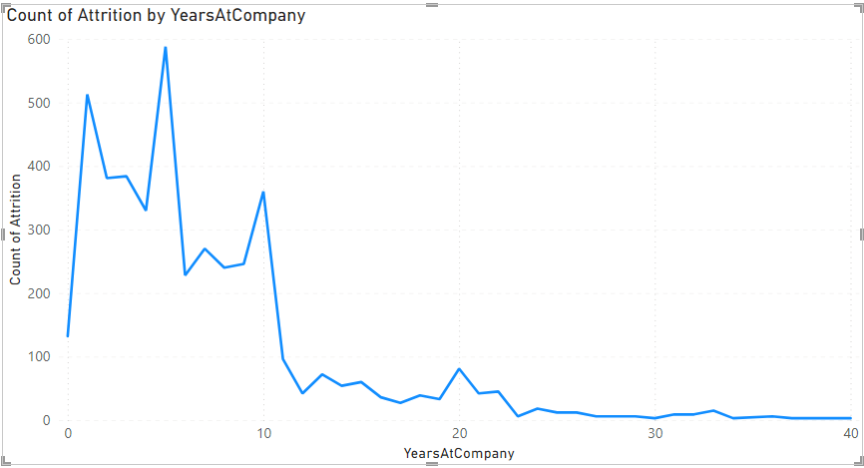
10.In Power BI, create a line chart that visualizes the trend of Employee Attrition over the years

Slide 12
11. Describe how you would create a star schema for this dataset, explaining the benefits of doing so.
Creating a star schema for an employee dataset involves designing a data model that separates dimensions and facts to optimize querying and reporting.
Steps to create a star schema:
Identify Dimensions and Facts:
Dimensions: These are the descriptive attributes of the data (e.g., employee, department, position).
Fact(s): These are the measurable metrics or numerical data (e.g., salary, hours worked).
Create Dimension Tables: For each dimension identified, create a separate dimension table.
Create a Fact Table: Design a central fact table containing the quantitative data, often related to transactions or events involving dimensions.
Establish Relationships: Create relationships between the primary key of the dimension tables and foreign keys in the fact table.
Maintain Referential Integrity: Ensure that foreign keys in the fact table have corresponding primary keys in the dimension tables. This maintains referential integrity and allows for accurate data analysis.
Benefits of using a star schema for an employee dataset:
The structure is intuitive and easy to understand, facilitating straightforward queries and analysis.
The schema's design optimizes query performance by reducing the number of joins required for analysis, leading to faster and more efficient data retrieval.
Scalability: It is scalable and adaptable to changing business requirements, allowing for the addition of new dimensions or facts.
Compatibility with BI Tools: Many business intelligence (BI) tools are designed to work well with star schemas, simplifying the process of creating reports and visualizations.

Slide 13
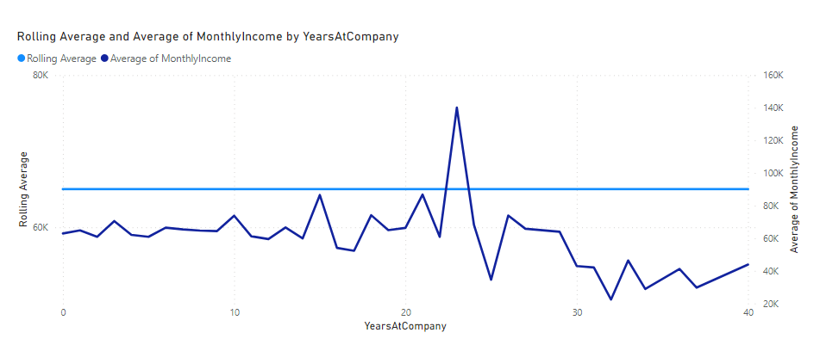
12. Using DAX, calculate the rolling 3-month average of Monthly Income for each employee.

Slide 14
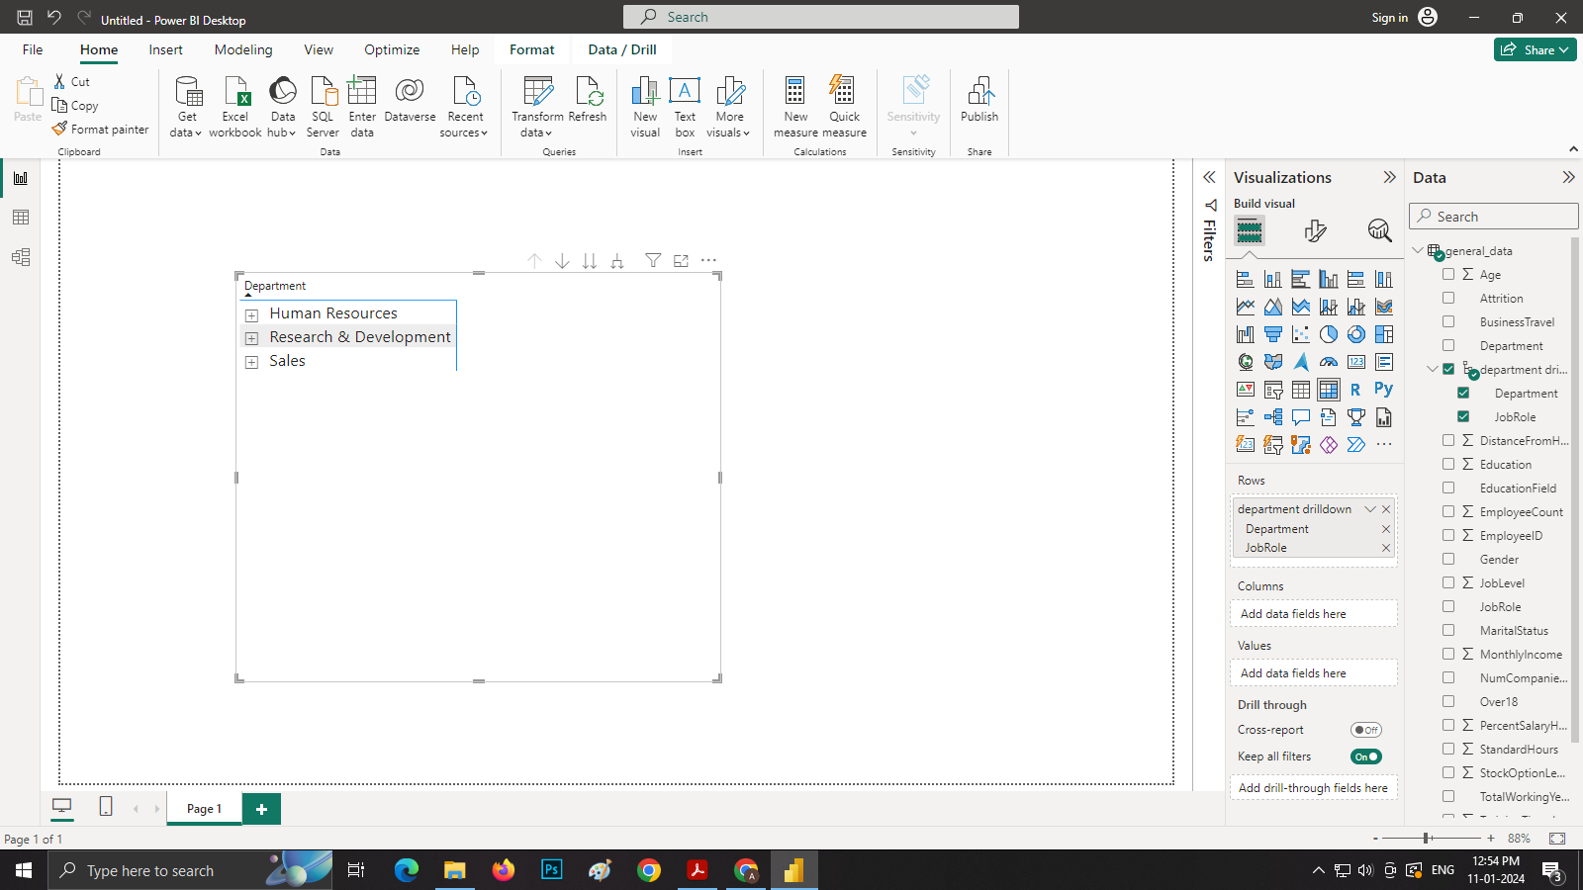
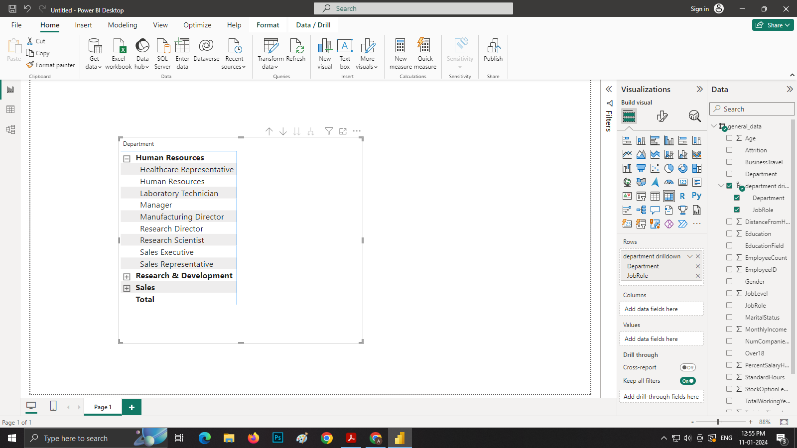
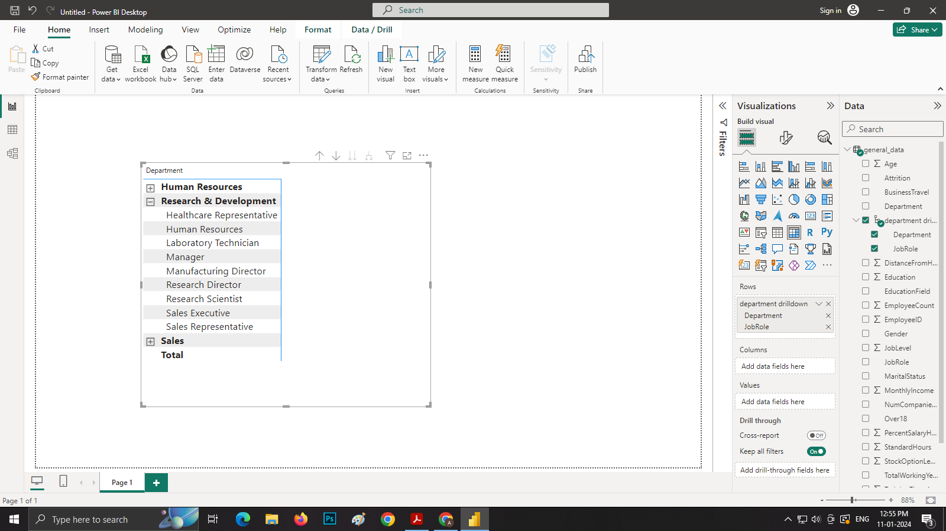

13. Create a hierarchy in Power BI that allows users to drill down from Department to Job Role to further narrow their analysis.

Slide 15
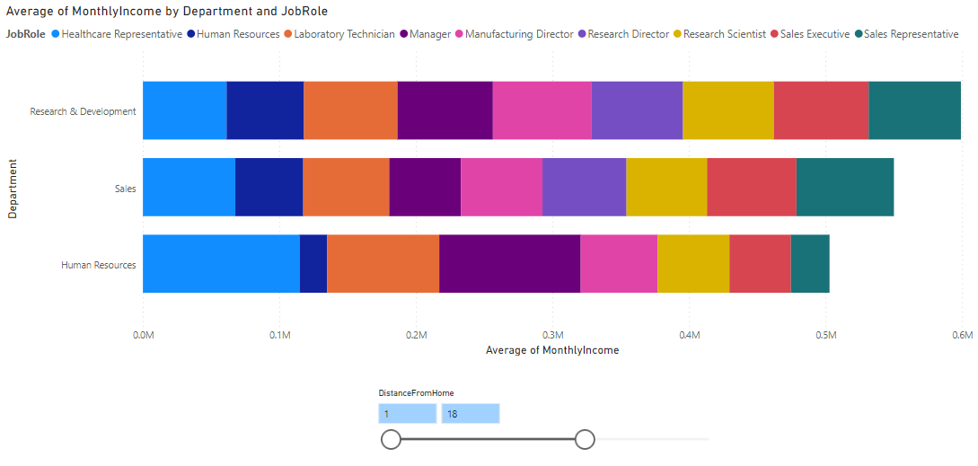
14. How can you set up parameterized queries in Power BI to allow users to filter data based on the Distance from Home column?

Slide 16
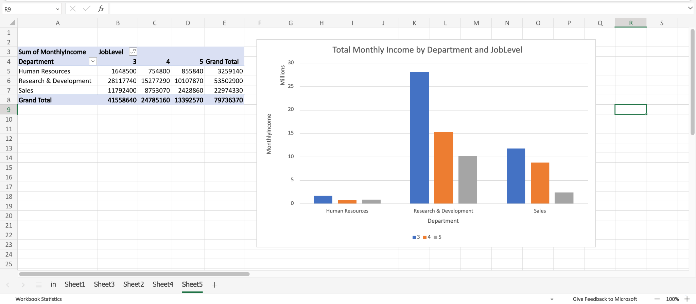
15. In Excel, calculate the total Monthly Income for each Department, considering only the employees with a Job Level greater than or equal to 3.
1

Slide 17
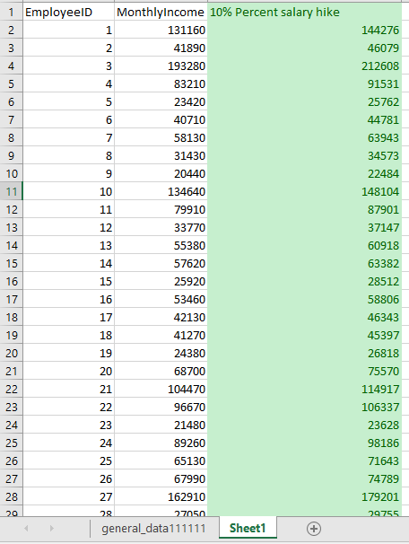
16. Explain how to perform a What-If analysis in Excel to understand the impact of a 10% increase in Percent Salary Hike on Monthly Income.
Steps:-
Create a new sheet and Copy “Monthly Income” column in it.
Calculate 10% salary hike in “Cell C2” of the “Cell B2” from monthly income column amount.
Select the whole Monthly Income data and the 10% salary hike column which has only one Value in the “Cell C2”.
Go to the "Data" tab in the Excel ribbon.
Click on "What-If Analysis" and choose "Data Table."
In the "Column input cell" field, select the “Cell B2”
In the "Row input cell" field, leave it blank since we are dealing with a one-variable table.
Click OK.

Slide 18
17. Verify if the data adheres to a predefined schema. What actions would you take if you find inconsistencies?
Verification:
Schema mapping: Map the predefined schema to the data format you're dealing with. This could involve identifying columns, data types, constraints, and relationships.
Data validation: Run checks against the mapped schema.
Data type validation: Ensure each data point conforms to the specified type (e.g., integer, string, date).
Missing value checks: Identify and handle missing values as per schema definition (e.g., allowed, imputed with default values).
Range checks: Verify if values fall within specified ranges (e.g., minimum and maximum values for numerical data).
Uniqueness checks: Ensure unique values where required by the schema (e.g., primary keys).
Foreign key checks: Validate references between related tables if applicable.
Pattern matching: Check for specific formats or regular expressions defined in the schema.
Handling inconsistencies:
Identify severity: Categorize inconsistencies based on their impact. Minor issues (e.g., formatting errors) might be tolerated, while major ones (e.g., invalid data types, missing critical values) could halt processing.
Implement correction strategies: Depending on the severity and type of inconsistency:
Automatic correction: Apply predefined rules to fix minor issues (e.g., standardizing date formats).
Flagging and manual review: Mark major inconsistencies for human intervention and decision-making. This might involve data cleaning, imputation, or rejection of invalid data points.
Exception handling: Implement specific routines to handle specific and recurring inconsistencies.
Reporting and logging: Document the encountered inconsistencies, including their type, frequency, and applied correction methods. This helps in data quality monitoring and future schema improvement.
Remember, the specific actions will depend on the context and nature of your data and schema. The goal is to strike a balance between data integrity and efficient processing, ensuring reliable and insightful analysis.

Slide 19
THANK YOU

